Slide 1


18ECO134T - Industrial Automation
UNIT - 1
SRM INSTITUTE OF SCIENCE AND TECHNOLOGY

Slide 2
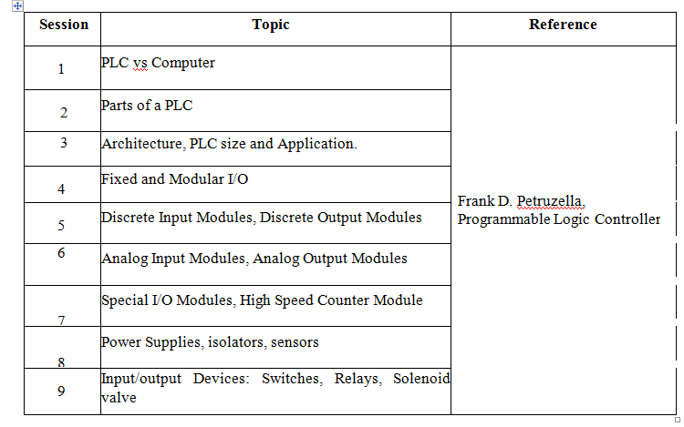
Contents

Slide 3
Introduction
Automation is a set of technologies that results in operation of machines and systems without significant human intervention and achieves performance superior to manual operation.
‘Automation’ is derived from Greek words
Auto - self
Matos - moving.
Automation therefore is the mechanism for systems that “move by itself”

Slide 4
Effects of automation
Increased productivity - Production can run round the clock, except for a few maintenance interval periods
Improved quality
Reduced operation time and work handling time
Reduced direct human labor costs and expenses
Reduced processing time - larger quantities can be shipped faster
Automation relieves people of boring, physically heavy or hazardous work

Slide 5
Programmable Logic Controller (PLC)
PLC is an assembly of solid state digital logic elements designed to make logical decisions and provide outputs to control the process.

Slide 6
History of PLC’s
First PLC was introduced in the late 1960s.
The automobile sector was the first industry to deploy PLCs into its operations.
Father of the PLC -Dick Morley
The first company to build PLC – Modicon

Slide 7
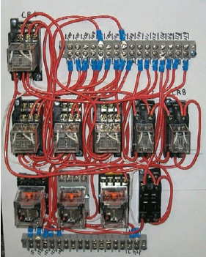
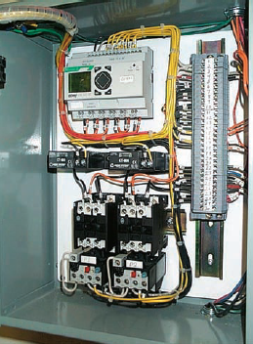
The Need for PLC’s
Relay based control panel.
PLC-based control panel
Relays have to be hardwired to perform a specific function.
The PLC has eliminated much of the hardwiring associated with
conventional relay control circuits.

Slide 8
What is a PLC ?
The PLC is an industrial computer used to control machines and process.
It is capable of storing instructions to implement control functions such as sequencing, timing, counting, arithmetic, data manipulation and communication.
The I/O interfaces provide the connection between the PLC and the inputs like pushbuttons, sensors,…and the outputs like valves, relays, lamps,….
In different areas of the industry PLC are being applied.
e.g.: materials handling, filling, packaging,..etc.

Slide 9
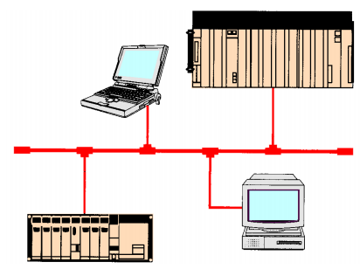
Advantages
Increased Reliability
More Flexibility.
Lower Cost.
Communications Capability
Faster Response Time.
Easier to Troubleshoot.

Slide 10
PLCs versus Computers
The PLC is designed to operate in the industrial environment with wide ranges of ambient temperature and humidity.
PLC is programmed in ladder logic or other easily learned languages.
Computers are complex computing machines capable
of executing several programs or tasks simultaneously
PLC control systems have been designed to be easily installed and maintained.

Slide 11
PLC | PC
Industrial environment | Office / Home environment
Wide ranges ambient temperature | Controlled low temperatures
Varied humidity | Controlled humidity
Varied dust/dirt | Controlled dust / dirt

Slide 12
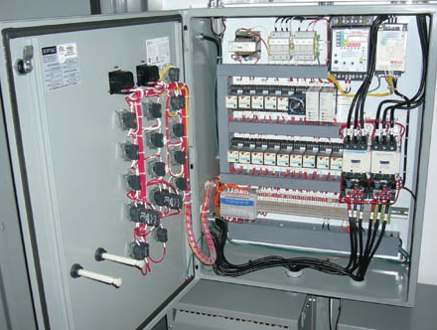
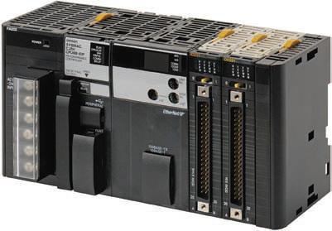
A PLC module
PLC installed in an industrial environment

Slide 13
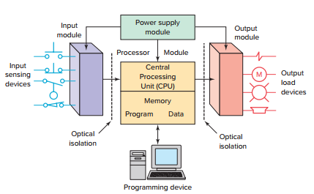
Parts of a PLC

Slide 14
Input / Output Module
Fixed I/O- typical of small PLCs that come in one package with no separate, removable units. The main advantage of this type of packaging is lower cost. One disadvantage of fixed I/O is its lack of flexibility.
Modular I/O - divided by compartments into which separate modules can be plugged. The main advantage of this type of packaging is flexibility.

Slide 15
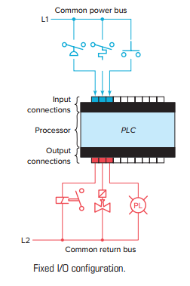
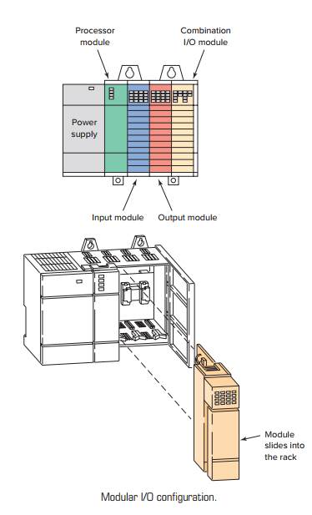

Slide 16
The I/O system forms the interface by which field devices are connected to the controller.
Input devices such as pushbuttons, limit switches, and sensors are hardwired to the input terminals.
Output devices such as small motors, motor starters, solenoid valves, and indicator lights are hardwired to the output terminals.
To electrically isolate the internal components from the input and output terminals, PLCs commonly employ an optical isolator, which uses light to couple the circuits together.

Slide 17
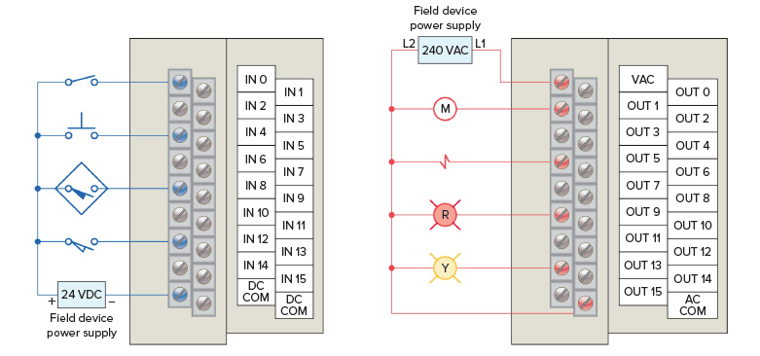
Typical PLC input/output

Slide 18
The power supply unit supplies DC power to other modules that plug into the rack.
The processor (CPU) is the “brain” of the PLC.
A typical processor usually consists of a microprocessor for implementing the logic and controlling the communications among the modules. The processor requires memory for storing user program instructions, numerical values, and I/O devices status.
A programming device is used to enter the desired
program into the memory of the processor. The program
can be entered using relay ladder logic, which is one of
the most popular programming languages.

Slide 19
PLC Size
The criteria used in categorizing PLCs include functionality, number of inputs and outputs, cost, and physical size.
The I/O count is the most important factor.
Nano PLC - less than 15 I/O points.
Micro PLC - 15 to 128 I/O points
Medium type -128 to 512 I/O points
Large type - over 512 I/O points.

Slide 20
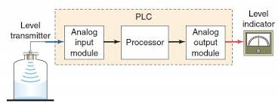
PLC Application
Types – Single ended, multitask, and control management
A single-ended or stand-alone PLC application involves one PLC controlling one process.

Slide 21
A multitask PLC application involves one PLC controlling several processes(Ex. Level, Flow etc.)

Slide 22
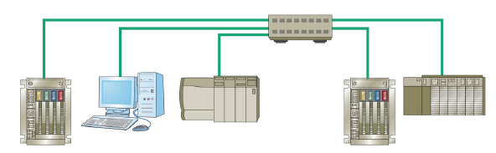
A control management PLC application involves one PLC controlling several other PLC’s
Requires large PLC processor
Control management PLC supervises several PLCs
• Downloads programs to other PLCs
• Specifies what operation needs done

Slide 23
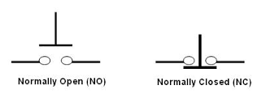
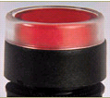
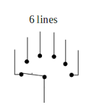
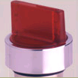
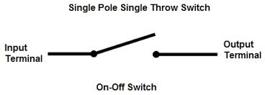
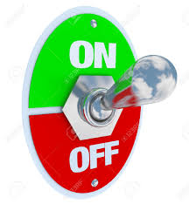
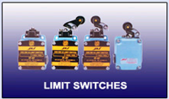
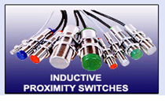
Inputs – Sample Pictures
Push Button
Selector Switch
Toggle Switch
23

Slide 24
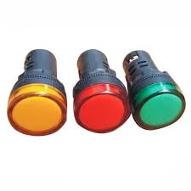
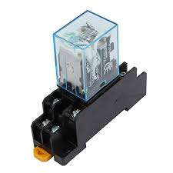
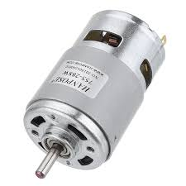
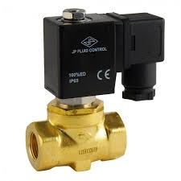
Outputs – Sample Pictures
Indicators
Relay
Motor
Solenoid valve

Slide 25
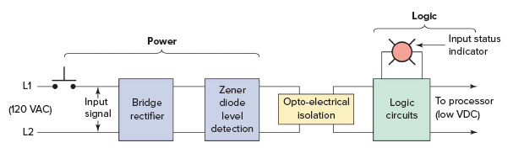
Discrete Input Module
This type of interface connects field input devices of the ON/OFF nature such as selector switches, pushbuttons, and limit switches.

Slide 26
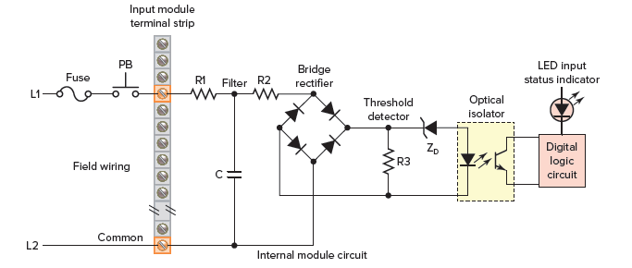
Discrete Input Module
Electrical optical isolator:
A device that couples input to output using a semiconductor light source and detector in the same package

Slide 27
When the pushbutton is closed, 120 VAC is applied to the bridge rectifier input.
This results in a low-level DC output voltage that is applied across the LED of the optical isolator.
The zener diode (ZD) voltage rating sets the minimum threshold level of voltage that can be detected.
When light from the LED strikes the phototransistor, it switches into conduction and the status of the pushbutton is communicated in logic to the processor.

Slide 28
Discrete input modules perform four tasks in the PLC control system.
Sense when a signal is received from a field device.
Convert the input signal to the correct voltage level for the particular PLC.
Isolate the PLC from fluctuations in the input
signal’s voltage or current.
Send a signal to the processor indicating which sensor originated the signal.

Slide 29
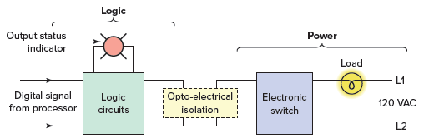
Discrete Output Module
This type of interface connects field output devices and turns the output load device on and off.

Slide 30
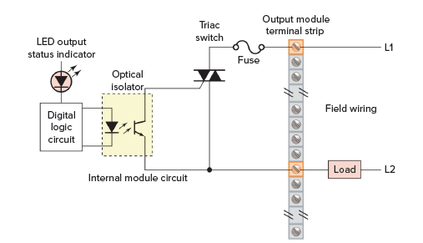
Discrete Output Module

Slide 31
When the processor calls for an output load to be energized, a voltage is applied across the LED of the opto-isolator.
The LED then emits light, which switches the phototransistor into conduction.
This in turn triggers the triac AC semiconductor switch into conduction, allowing current to flow to the output load.
Since the triac conducts in either direction, the output to the load is alternating current.

Slide 32
As with input circuits, the output interface is usually provided with LEDs that indicate the status of each output.
The triac cannot be used to switch a DC load.

Slide 33
Analog I/O Modules
Analog devices represent physical quantities that can have an infinite number of values. Typical analog inputs and outputs vary from 0 to 20 mA, 4 to 20 mA, or 0 to 10V.
Analog sensors measure a varying physical quantity over a specific range and generate a corresponding voltage or current signal.
Common physical quantities measured by a PLC analog
module include temperature, speed, level, flow, weight, pressure, and position.

Slide 34
Example
PLC analog input and output modules are used in measuring and displaying the level of fluid in a tank.

Slide 35
The analog input interface module contains the circuitry necessary to accept an analog voltage or current signal from the level transmitter field device.
This input is converted from an analog to a digital value for use by the processor.
The circuitry of the analog output module accepts the digital value from the processor and converts it back to an analog signal that drives the field tank level meter.

Slide 36
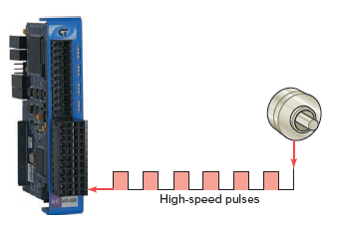
Special I/O Modules
HIGH-SPEED COUNTER MODULE
It is used to count pulses from sensors, encoders, and switches that operate at very high speeds.
A typical count rate available is 0 to 100 kHz, which means the module would be able to count 100,000 pulses per second.

Slide 37
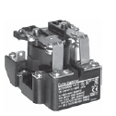
Electromagnetic Control Relays
An electrical relay is a magnetic switch. It uses electromagnetism to switch contacts.
A relay will usually have only one coil but may have any number of different contacts.
Used to handle heavy current or high voltage
a coil
a switch
a iron core
iron bar connected to the switch

Slide 38

How does a Relay work ?
A
230 V
AC
24 V

Slide 39
How does a Relay work ?
When a current goes through the coil a magnetic field is produced in the coil and the iron core in the coil becomes magnetic.
A
I₁
230 V
AC
24 V

Slide 40
How does a Relay work ?
The electromagnetic force pulls in the switch and...
A
I₁
230 V
AC
24 V

Slide 41

How does a Relay work ?
…a current can go through the switch.
A
I₁
I₂
230 V
AC
24 V

Slide 42
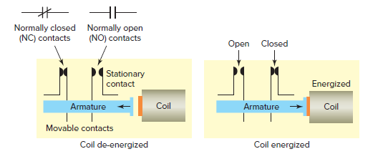
Relay normally open and normally closed contacts.

Slide 43
Switches
Manually operated switches -are controlled by hand. These include toggle switches, pushbutton switches, knife switches, and selector switches.
Mechanically operated switches - are controlled automatically by factors such as pressure, position, or temperature.

Slide 44
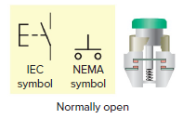
Manually operated switches
Pushbutton switches - It operates by opening or closing contacts when pressed.
Normally open (NO) pushbutton, which makes a circuit when it is pressed and returns to its open position when the button is released.

Slide 45
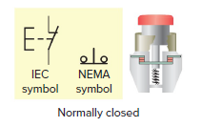
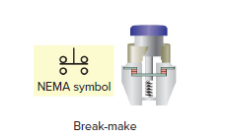
Normally closed (NC) pushbutton, which opens the
circuit when it is pressed and returns to the closed
position when the button is released.
Break-before-make pushbutton in which the top section contacts are NC and the bottom section contacts are NO. When the button is pressed, the top
contacts open before the bottom contacts are closed.

Slide 46
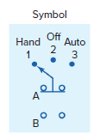
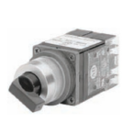
Selector switch
Switch positions are established by turning the operator knob right or left. Selector switches may have two or more selector positions

Slide 47
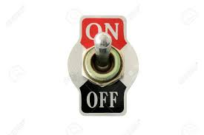

Toggle Switch
Toggle switches are actuated by a lever angled in one of two or more positions. The common light switch used in household wiring is an example of a toggle switch.

Slide 48
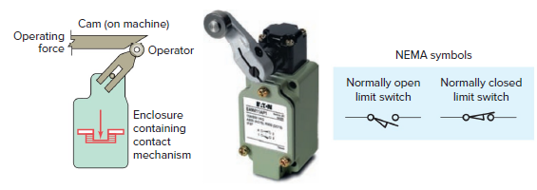
Mechanically Operated Switches
Limit switch
Limit switches are designed to operate only when a predetermined limit is reached, and they are usually actuated by contact with an object such as a cam.
They are often used in the control circuits of machine processes to govern the starting, stopping, or reversal of motors.

Slide 49
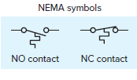
Temperature switch, or thermostat
These switches open or close when a designated temperature is reached.
Industrial applications for these devices include maintaining the desired temperature range of air, gases, liquids, or solids.

Slide 50
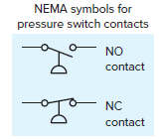
Pressure switches
used to control the pressure of liquids and gases.
They are all basically designed to actuate (open or close) their contacts when a specified pressure is reached.
Pressure switches can be pneumatically (air) or hydraulically (liquid) operated switches.
Generally, bellows or a diaphragm presses up against a small microswitch and causes it to open or close.

Slide 51
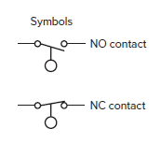
Level switches
used to sense liquid levels in vessels
and provide automatic control for motors that transfer liquids from sumps or into tanks.

Slide 52
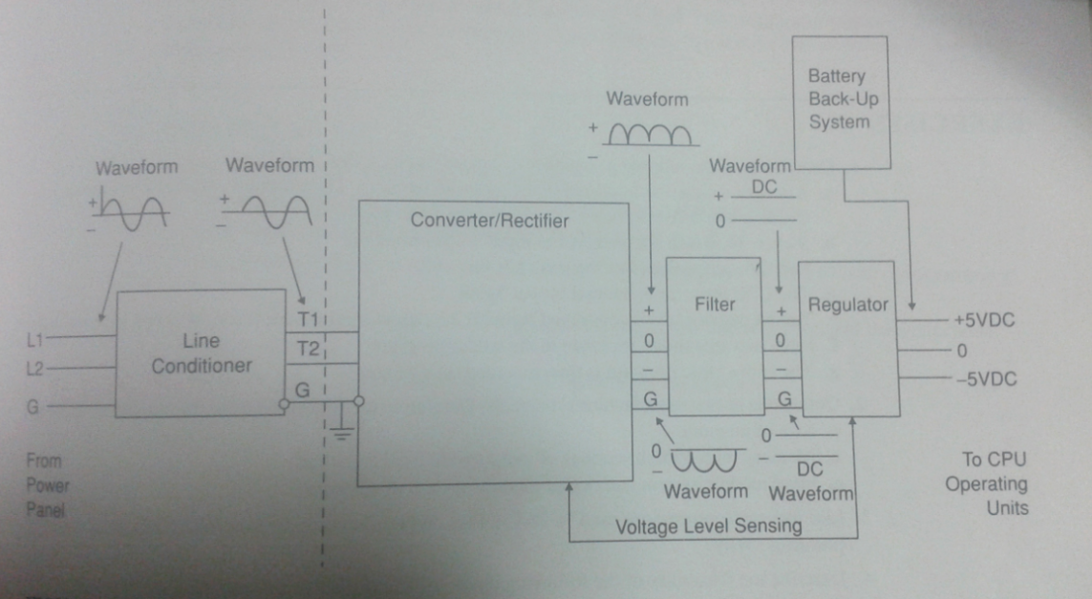
Power Supply

Slide 53
Sensors
Sensors are used for detecting, and often measuring, the magnitude of something.
They convert mechanical, magnetic,
thermal, optical, and chemical variations into electric voltages and currents.

Slide 54
Types
Proximity Sensor
Magnetic Reed Switch
Light Sensors
Ultrasonic Sensors
Strain/Weight Sensors
Temperature Sensors
Flow Measurement
Velocity and Position Sensors

Slide 55
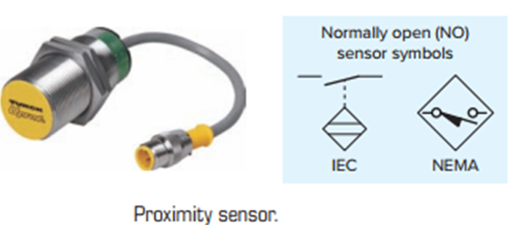
Proximity Sensor
Proximity sensors or switches, are pilot devices that detect the presence of an object (usually called the target) without physical contact.

Slide 56
Inductive-type proximity sensor
Used to detect both ferrous metals (containing iron) and nonferrous metals (such as copper, aluminum, and brass).
Inductive proximity sensors operate under the electrical principle of inductance, where a fluctuating current induces an electromotive force (emf) in a target object.

Slide 57
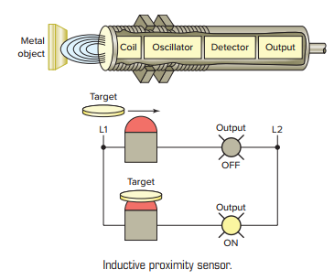
The oscillator circuit generates a high-frequency electromagnetic field that radiates from the end of the sensor.
• When a metal object enters the field, eddy currents are induced in the surface of the object.
• The eddy currents on the object absorb some of the radiated energy from the sensor, resulting in a loss of energy and change of strength of the oscillator.

Slide 58
The sensor’s detection circuit monitors the oscillator’s strength and triggers a solid-state output at a specific level.
Once the metal object leaves the sensing area, the oscillator returns to its initial value.

Slide 59
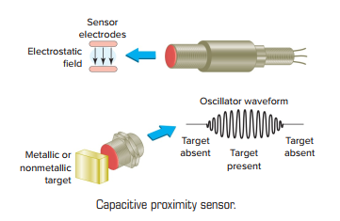
Capacitive proximity sensors
Senses both conductive and nonconductive materials such as paper, glass, liquids, and cloth.

Slide 60
Operation
A capacitive sensor contains a high-frequency oscillator along with a sensing surface formed by two metal electrodes.
When the target nears the sensing surface, it enters the electrostatic field of the electrodes and changes the capacitance of the oscillator.
As a result, the oscillator circuit begins oscillating and changes the output state of the sensor when it reaches a certain amplitude.
As the target moves away from the sensor, the oscillator’s amplitude decreases, switching the sensor back to its original state.

Slide 61
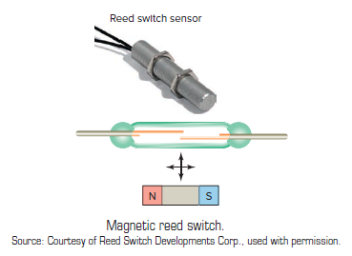
Magnetic Reed Switch
A magnetic reed switch is composed of two flat contact tabs that are hermetically sealed (airtight) in a glass tube filled with protective gas.

Slide 62
Light Sensors
A photoelectric sensor – It is an optical control device that operates by detecting a visible or invisible beam of light and responding to a change in the received light intensity.

Slide 63
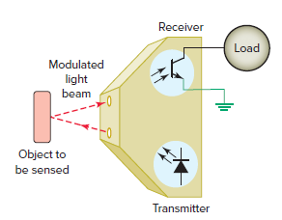
The transmitter contains a light source, usually an LED along with an oscillator.
The oscillator modulates or turns the LED on and off at a high rate of speed.
The transmitter sends this modulated light beam to the receiver.
The receiver decodes the light beam and switches
the output device, which interfaces with the load.

Slide 64
Ultrasonic Sensors
An ultrasonic sensor operates by sending high-frequency sound waves toward the target and measuring the time it takes for the pulses to bounce back.
The time taken for this echo to return to the sensor is directly proportional to the distance or height of the object because sound has a constant velocity.

Slide 65
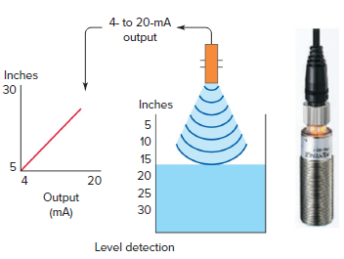
A practical application in which the returning echo signal is electronically converted to a 4 to 20 mA output.
The 4- to 20-mA mA represents the sensor’s measurement span.
The sensor will proportionately generate a 4-mA signal when the tank is empty and a 20-mA signal when the tank is full.

Slide 66
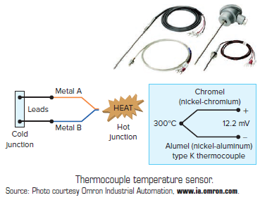
Temperature Sensors
The thermocouple is the most widely used temperature sensor.
Thermocouples operate on the principle that when two dissimilar metals are joined, a predictable DC voltage will be generated that relates to the difference in temperature between the hot junction and the cold junction

Slide 67
Resistance temperature detectors (RTDs) are wire wound temperature-sensing devices that operate on the
principle of the positive temperature coefficient (PTC) of
metals.
That means the electrical resistance of metals is directly
proportional to temperature.
Platinum is the material most often used in RTDs because of its superiority regarding temperature limit, linearity, and stability.

